Slide 1
Blocking and Non-blocking Assignment

Slide 2
Blocking Assignment
Blocking assignment statements are assigned using = and are executed one after the other in a procedural block. However, this will not prevent execution of statements that run in a parallel block.

Slide 3
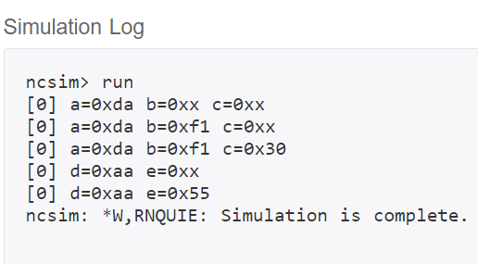
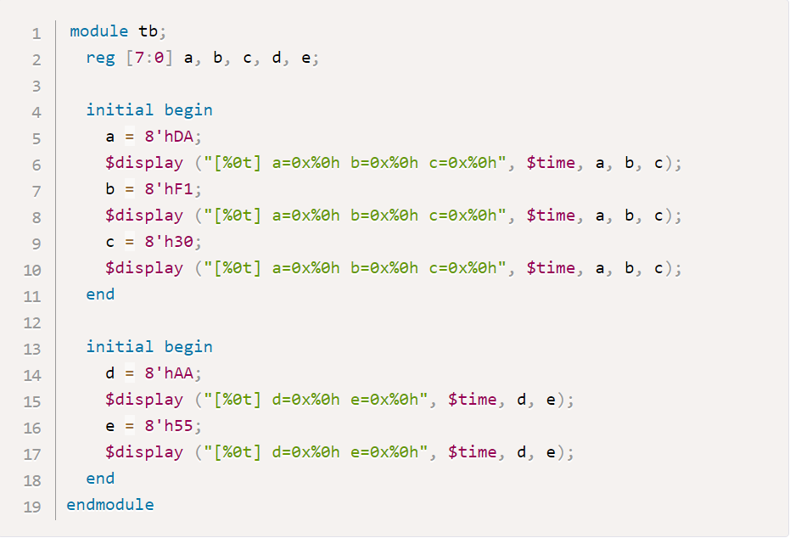
Blocking

Slide 4
Note that there are two initial blocks which are executed in parallel when simulation starts.
Statements are executed sequentially in each block and both blocks finish at time 0ns.
To be more specific, variable a gets assigned first, followed by the display statement which is then followed by all other statements. This is visible in the output where variable b and care 8'hxx in the first display statement. This is because variable b and c assignments have not been executed yet when the first $display is called.

Slide 5
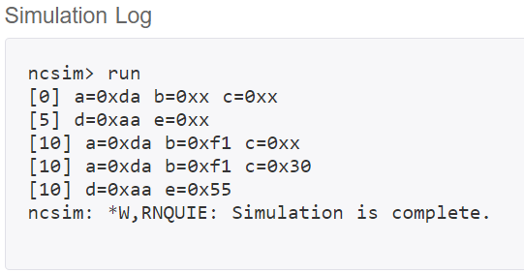
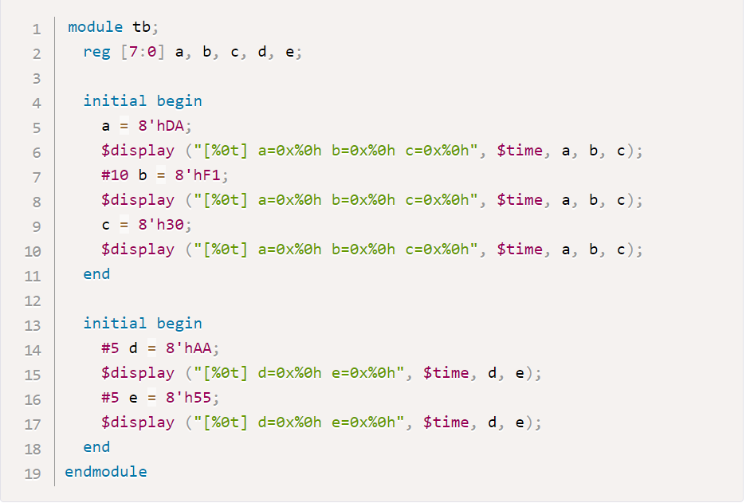
blocking

Slide 6
Non-blocking Assignment
Non-blocking assignment allows assignments to be scheduled without blocking the execution of following statements and is specified by a “<=“ symbol.
It's interesting to note that the same symbol is used as a relational operator in expressions, and as an assignment operator in the context of a non-blocking assignment.
If we take the first example from above, replace all “=“ symbols with a non-blocking assignment operator <=,we'll see some difference in the output.

Slide 7
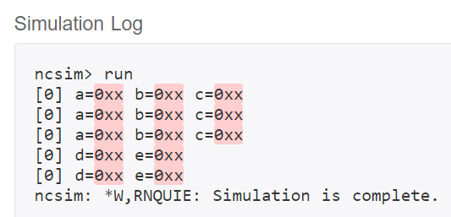
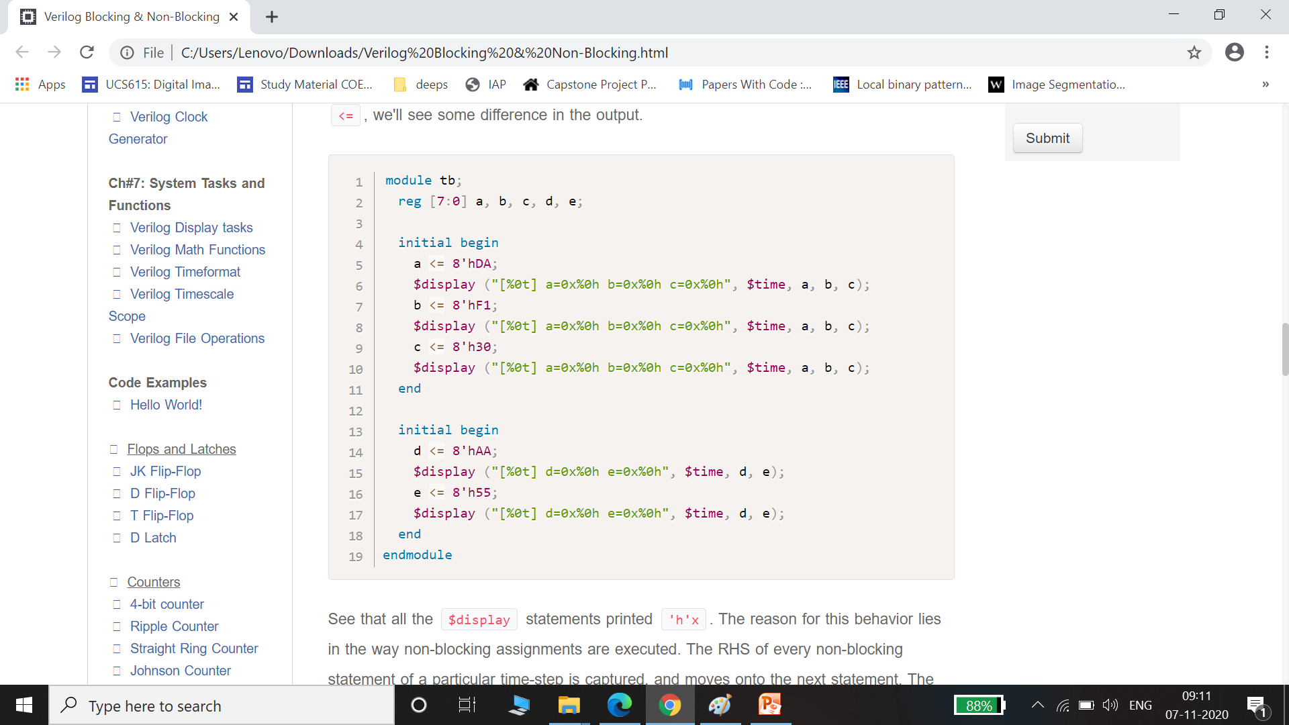
Non blocking

Slide 8
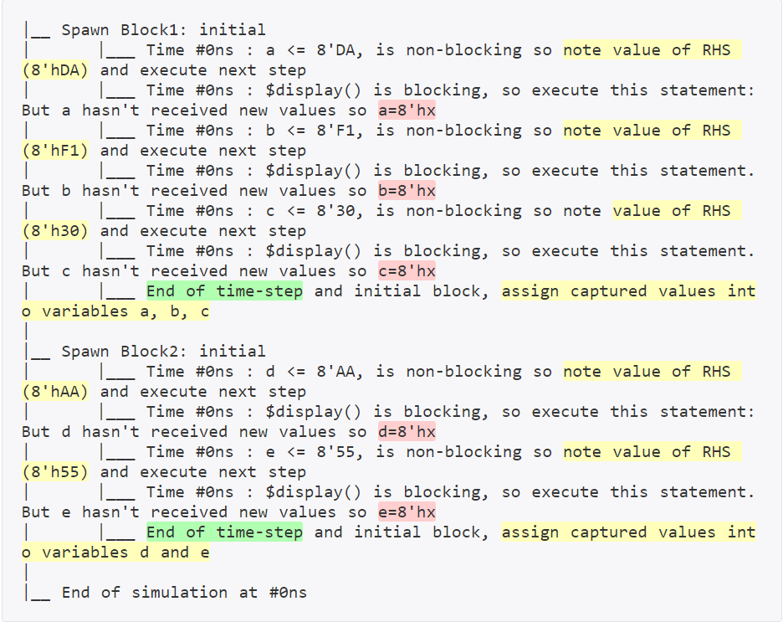

Slide 9
See that all the $display statements printed 'h'x. The reason for this behavior lies in the way non-blocking assignments are executed. The RHS of every non-blocking statement of a particular time-step is captured, and moves on to the next statement.
The captured RHS value is assigned to the LHS variable only at the end of the time-step.

Slide 10
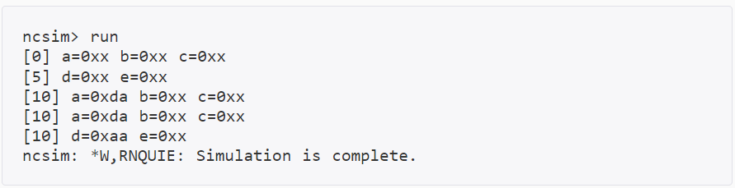
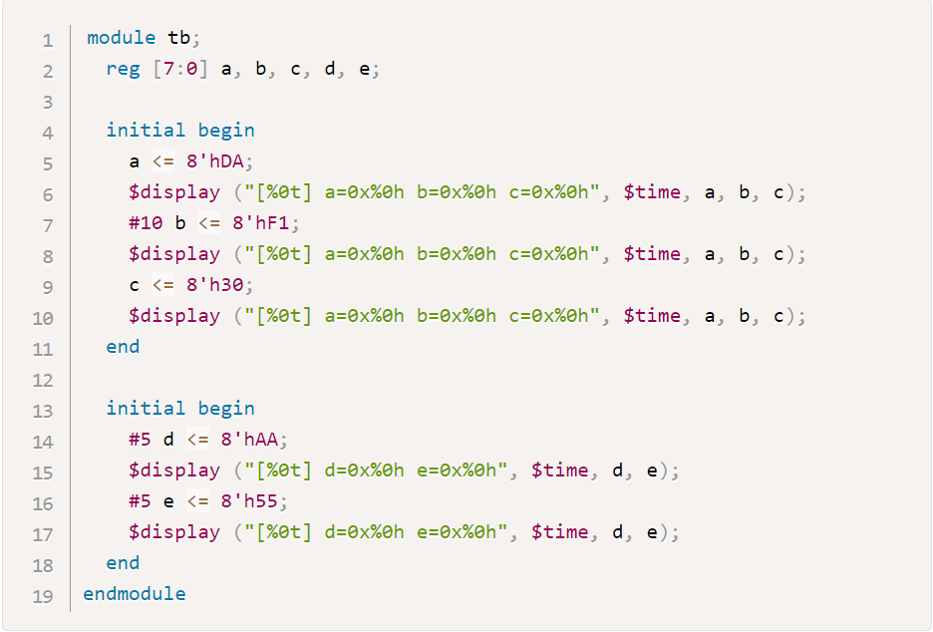
Non blocking

Slide 11
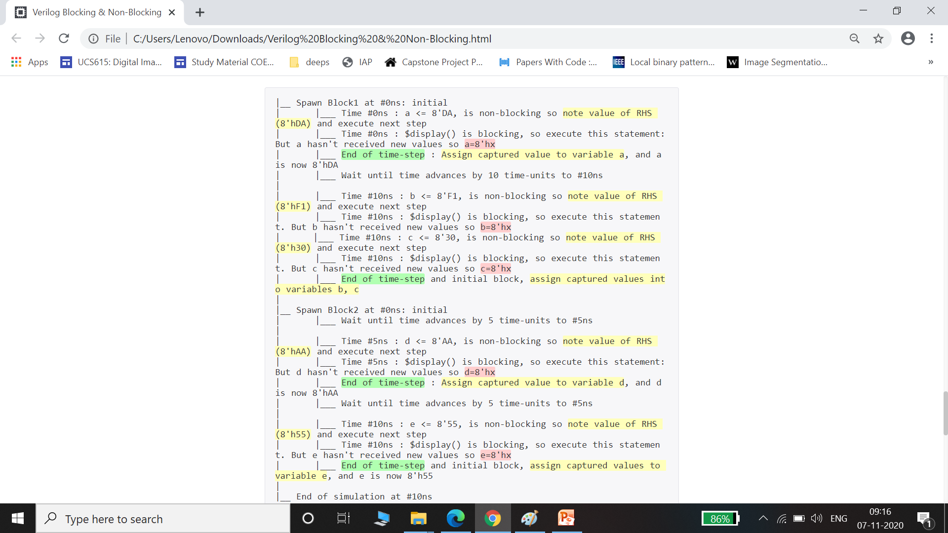

Slide 12
Final Word
For blocking and non-blocking assignments, the general rule is to use blocking assignments when dealing with purely combinatorial logic and to use non-blocking assignments when dealing with sequential logic with storage such as latches or flip-flops.
The reason for the latter is that a non-blocking assignment, when executed, captures the current values of all of the variables on the RHS ( Right Hand Side ) of the assignment and then, at the end of the current simulation cycle, those captured values are assigned to the variables on the LHS. This mimics the behavior of latches and flip-flops w.r.t. their internal propagation delay in the real world.

